Slide 1



A Balancing Mobile Robot
Group Number:
Ju Jialin,
Huang Xiaoying,
Huang Jian
Liu Zhaoyue,
Hou Yabin

Slide 2
Contents
01
1 Project Overview and
Team Member Roles
02
2 Modeling and Simulation
03
3 Hardware Design
04
4 Software Design
05
5 Results
06
6 Summary and
Outlook

Slide 3

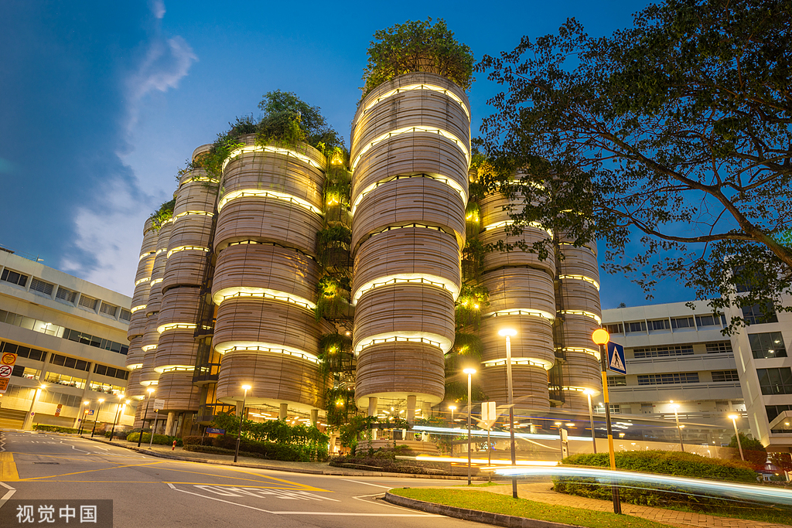
PART01
Project Overview and Team Member Roles
By Hou Yabin(G2404965A)

Slide 4

Project Overview
Modeling and Simulation
Hardware Design
Software Design
Kinematic model
Simulink Simulation model
Esp32
Motor
MPU6050
Ultrasonic
Bluetooth
PID control algorithm
Kalman filter
Bluetooth remote control
Hardware driver
OLED display

Slide 5
Team Member Role
Ju Jialin
Huang Xiaoying
Huang Jian
Liu Zhaoyue
Hou Yabin
Team Leader
imscape 3D modeling;
Bluetooth remote control mobile App design;
Inclination calculation based on kalman filter and motion sensor MPU6050
Bluetooth communication implementation
Kinetic model
Incorporating state-space representation for precise stability and control analysis
PID control implementation
ESP32 control program
Kinetic Model
Simulink simulation model of control system
Low-level hardware driver
Hardware design and fabricate
Hardware design and integration
System block diagram drawing
Schematic analysis and drawing
Auxiliary PID algorithm parameter adjustment
Simulink simulation model of control system
Control algorithm design
Preliminary tuning of PID parameters
Ultrasonic module driver

Slide 6
PART02
Modeling and Simulation
By Huang Jian( )

Slide 7
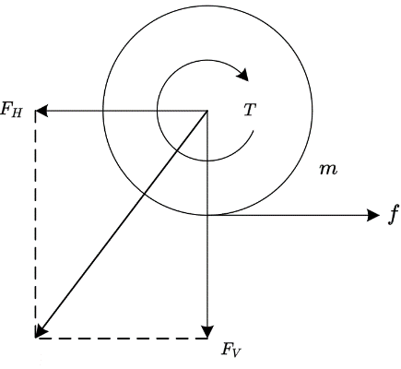
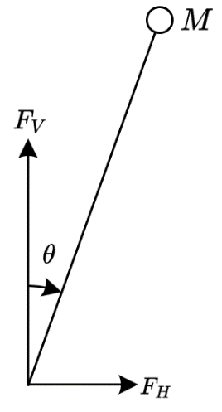
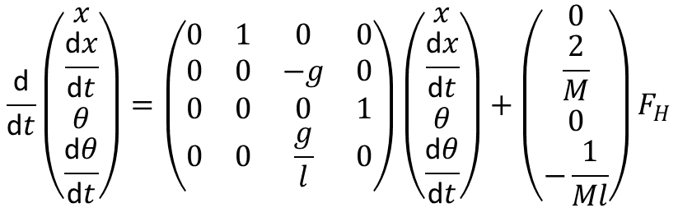
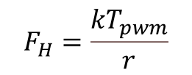
Modeling and Simulation
Because the wheel is light enough to ignore its weight, we can obtain:
$$F_{H}=\frac{kT_{pwm}}{r}$$
Then do analysis on car body, we can obtain state-space equation:
$$\frac{\text{d}}{\text{d}t}\left(\begin{matrix}x \\ \frac{\text{d}x}{\text{d}t} \\ θ \\ \frac{\text{d}θ}{\text{d}t}\end{matrix}\right)=\left(\begin{matrix}0 & 1 & 0 & 0 \\ 0 & 0 & −g & 0 \\ 0 & 0 & 0 & 1 \\ 0 & 0 & \frac{g}{l} & 0\end{matrix}\right)\left(\begin{matrix}x \\ \frac{\text{d}x}{\text{d}t} \\ θ \\ \frac{\text{d}θ}{\text{d}t}\end{matrix}\right)+\left(\begin{matrix}0 \\ \frac{2}{M} \\ 0 \\ −\frac{1}{Ml}\end{matrix}\right)F_{H}$$

Slide 8
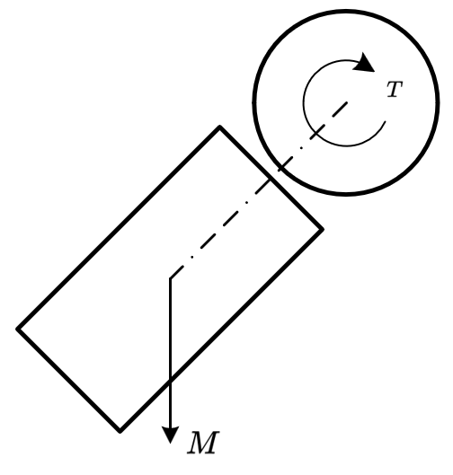
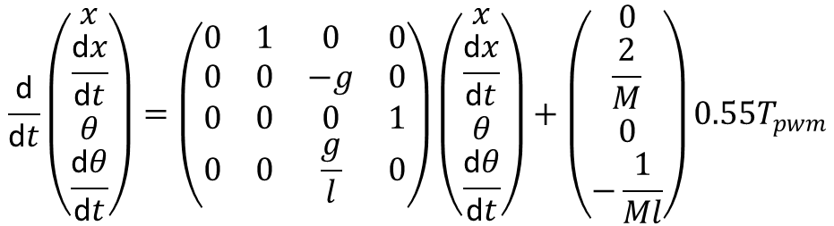
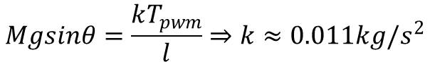
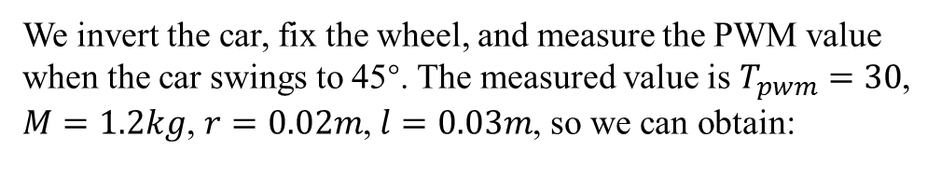
Modeling and Simulation
We invert the car, fix the wheel, and measure the PWM value when the car swings to 45°. The measured value is$T_{pwm}=30$, $M=1.2kg$, $r=0.02m$, $l=0.03m$, so we can obtain:
$$Mgsinθ=\frac{kT_{pwm}}{l}⇒k≈0.011kg/s^{2}$$
So we get the final state-space equation
Obtain Coefficient
$$\frac{\text{d}}{\text{d}t}\left(\begin{matrix}x \\ \frac{\text{d}x}{\text{d}t} \\ θ \\ \frac{\text{d}θ}{\text{d}t}\end{matrix}\right)=\left(\begin{matrix}0 & 1 & 0 & 0 \\ 0 & 0 & −g & 0 \\ 0 & 0 & 0 & 1 \\ 0 & 0 & \frac{g}{l} & 0\end{matrix}\right)\left(\begin{matrix}x \\ \frac{\text{d}x}{\text{d}t} \\ θ \\ \frac{\text{d}θ}{\text{d}t}\end{matrix}\right)+\left(\begin{matrix}0 \\ \frac{2}{M} \\ 0 \\ −\frac{1}{Ml}\end{matrix}\right)0.55T_{pwm}$$

Slide 9
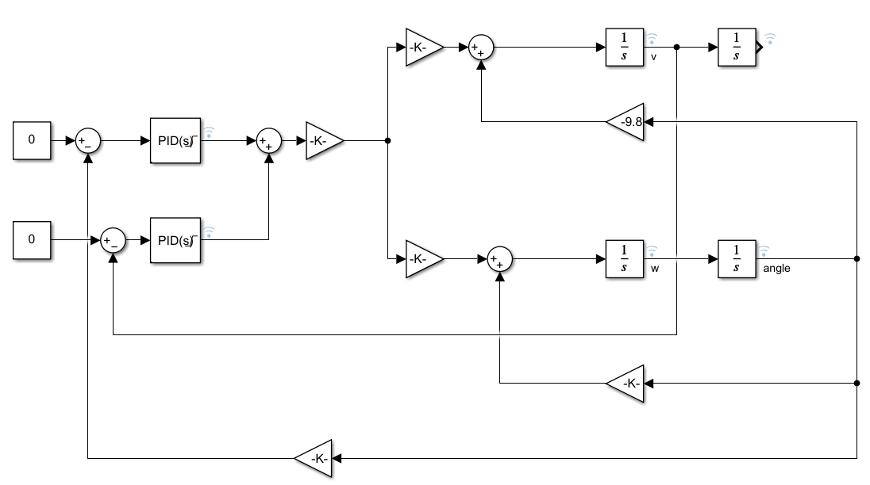
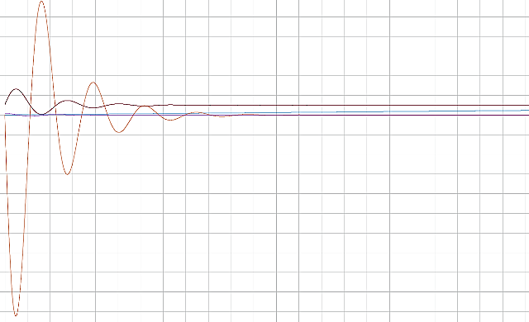
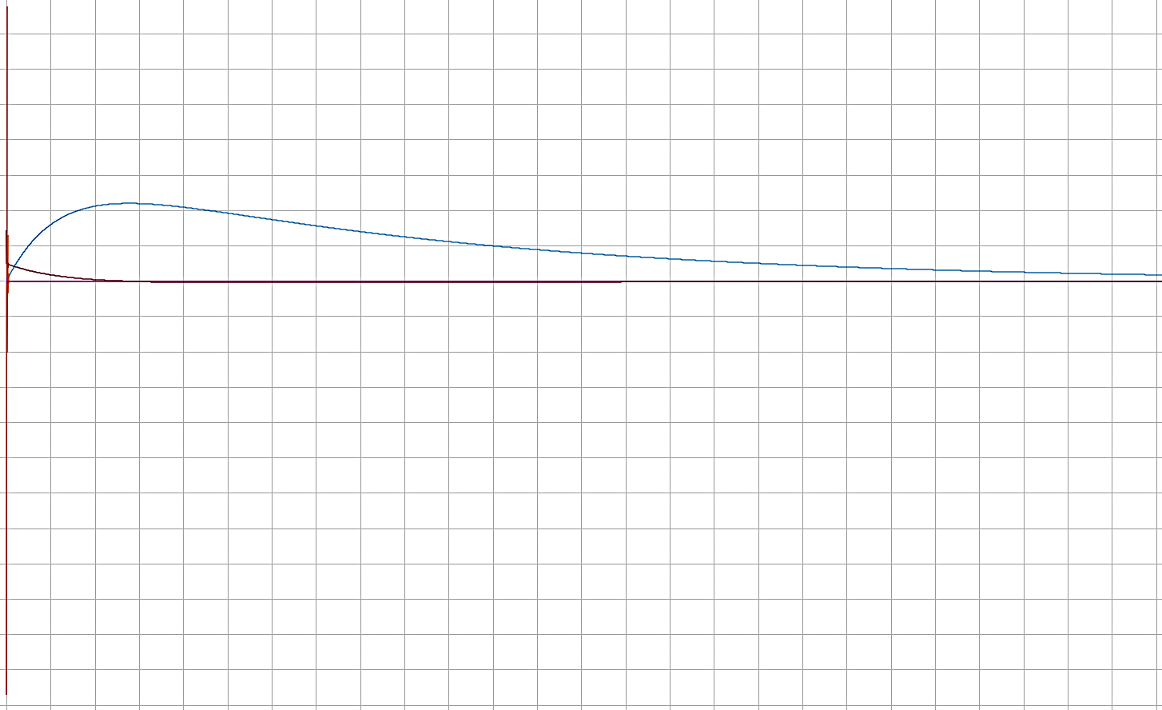
Modeling and Simulation
Using Simulink we can simulate the dynamic model with actual parameters which can be implemented into our program.
Simulink Module
Vertical Control Loop Simulation Result
Vertical and Verlocity control loop result

Slide 10
PART03
Hardware Design
By Liu Zhaoyue( )

Slide 11
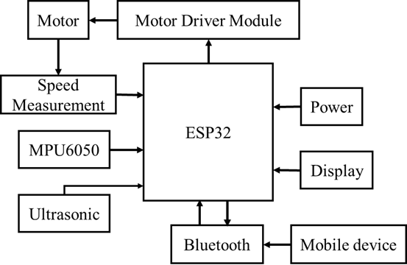
Hardware Design
Overall System Hardware Scheme:

Slide 12
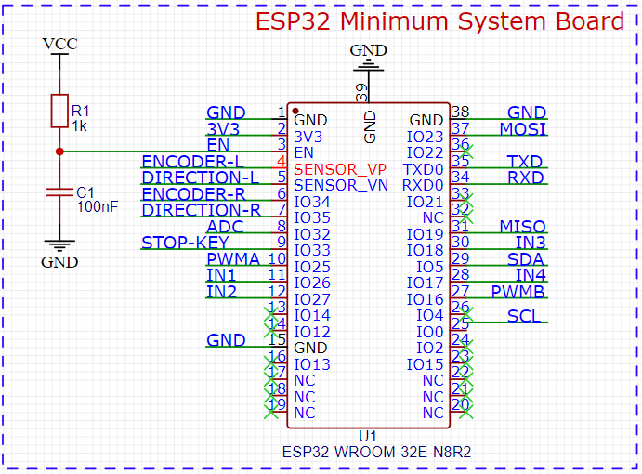
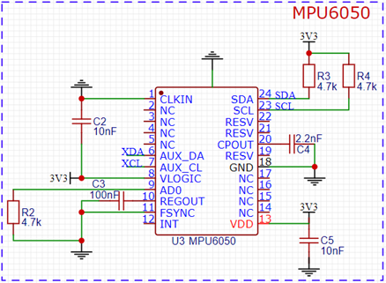
Hardware Design
ESP32 Minimal System Board:
Attitude sensor MPU6050:

Slide 13
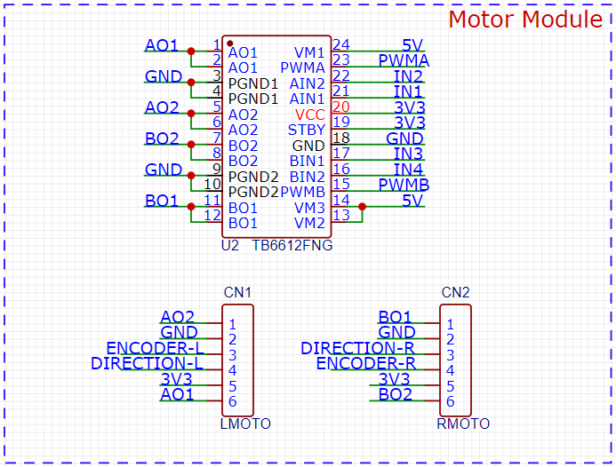
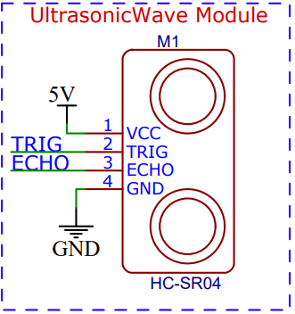
Hardware Design
Motor Driver Module:
Ultrasonic Wave Module:

Slide 14
PART04
Software design
By Ju Jialin(G2305559A)

Slide 15

Operating system
Balance control task (highest priority)
OLED display task (lowest priority)
Obstacle avoidance task
create multiple tasks
assign priorities
Allocate resources efficiently Integrate new features easily

Slide 16
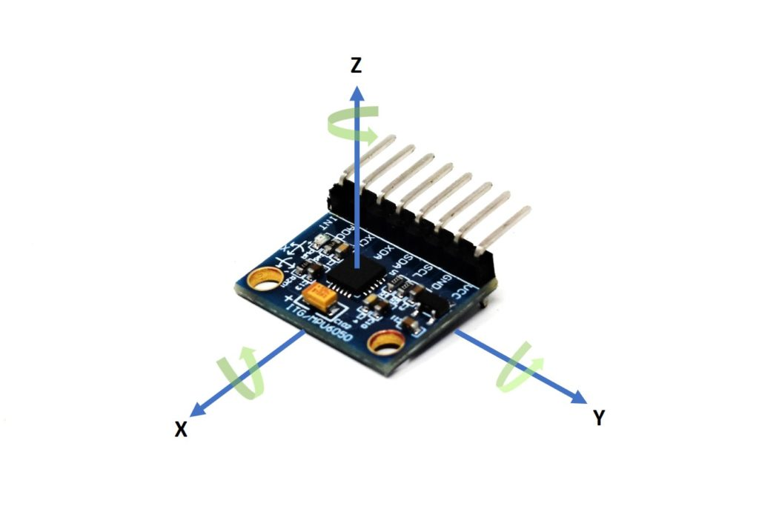
Calculate tilt angle
MPU6050:
3-axis accelerometer
3-axis gyroscope
in static or low-speed situations
track rapid angular changes
Kalman filter:
Combine the strengths
Higher accuracy than complementary filter

Slide 17
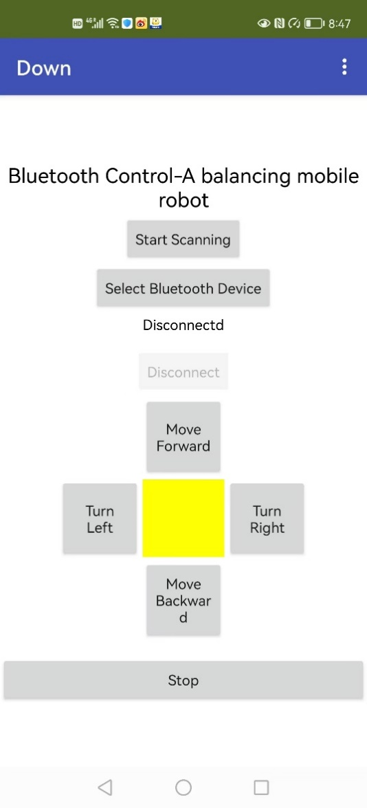
BLE communication and remote control
ESP32——server
Mobile phone——Client
MIT APP inventor

Slide 18
Balance control task
Start
If the system is running
No
Yes
Update time interval and calculate tilt angle
Yes
System stop
Check if the tilt angle is too big
Reset parameters
Calculate motor speed
Calculate tilt angle
PID controller output
Yes
No
Yes
Check if the tilt angle is within(-3,3)
Check if the speed is too high
No
Calculate the PWM

Slide 19
PART05
Result
By Hou Yabin(G2404965A)

Slide 20
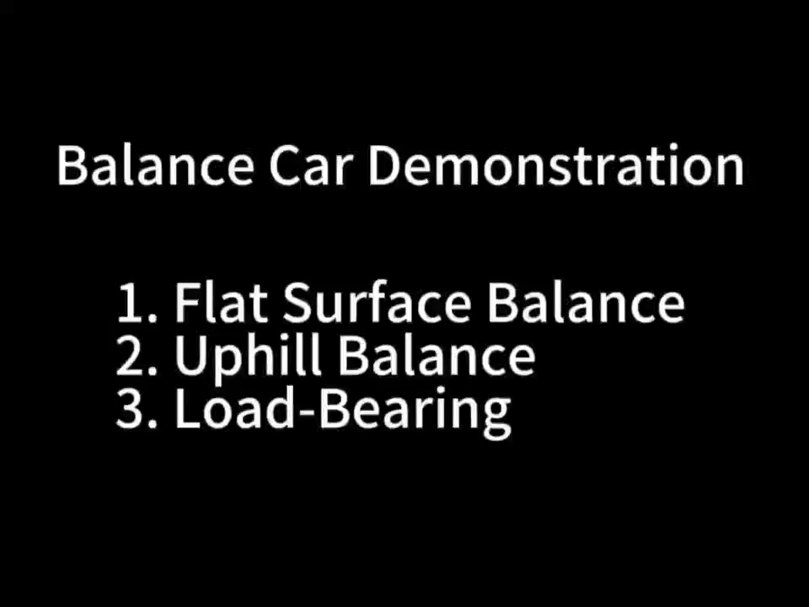
Result

Slide 21
PART06
Summary and
Outlook
By Hou Yabin(G2404965A)

Slide 22
Project Overview
Summary
Outlook
basic functions:
Staying upright
moving forward & backward
Turning
Extra function:
Bluetooth remote control
Ultrasonic sensor
Optimized program framework
Target following
Obstacle avoidance

Slide 23
END
Thanks for your watching

